Slide 1
Introduction to Fundamentals in Python (Intermediate)
Kenny Choo and Oka Kurniawan

Slide 2
On Video Camera
Please turn on your video camera for TWO reasons:
It helps the instructors to know someone is there (it really makes a difference)
This is required for SSG audit submission for online learning

Slide 3
The Aim of the Course
The aim of the course is to strengthen algorithmic thinking and skills of the participants to equip them in their software development career. The course uses Python programming language as a medium to equip participants with computer science concepts. The course gives an overview to algorithms, some data structures, object oriented programming, functional programming, and testing.

Slide 4
Topics and Schedule
Time | Topics
Day 1 | Python Revision Testing and debugging
Day 2 | Intro to Algorithm Recursion
Day 3 | Introduction to Object Oriented Programming
Day 4 | Test Driven Development Functional Programming

Slide 5
What You Need to Know To Take This Class
Some basic programming skill either in Python or in other languages

Slide 6
Assessments
Problem Sets: 50%
Projects: 50%
Mini Projects: 20%
Final Project: 30%
Grading Policy:
Most submission is TWO weeks from the day it is released.
You have ONE additional week with 50% grade.
You can get a few bonus points if you submit ONE week earlier.

Slide 7
How the Class Will be Conducted
Read the class Notes
Attend the Class and do the Cohort Problem Set
Do the Homework Problem Set between the lessons
Do the Mini Projects outside of class

Slide 8
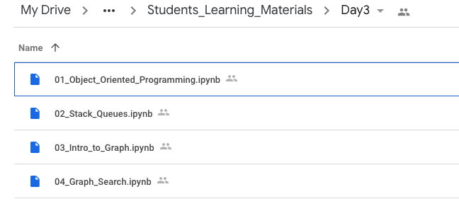
Course Notes

Slide 9
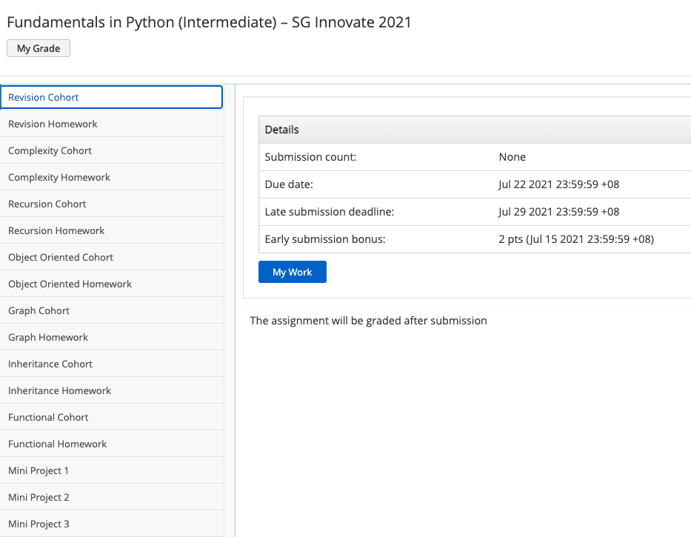
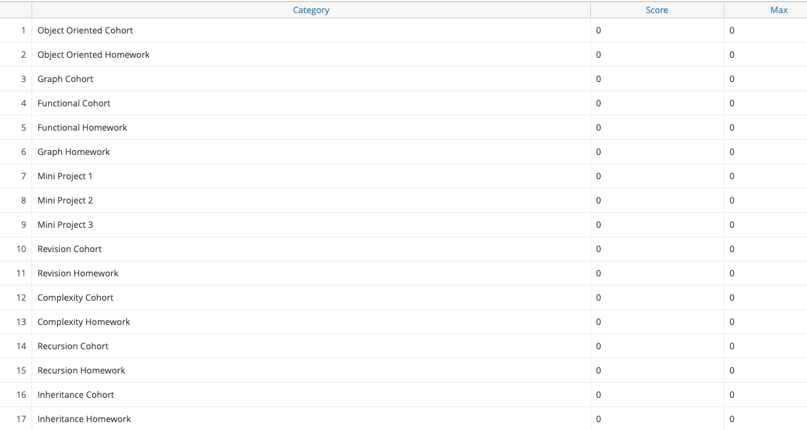
Problem Sets
labs.vocareum.com

Slide 10
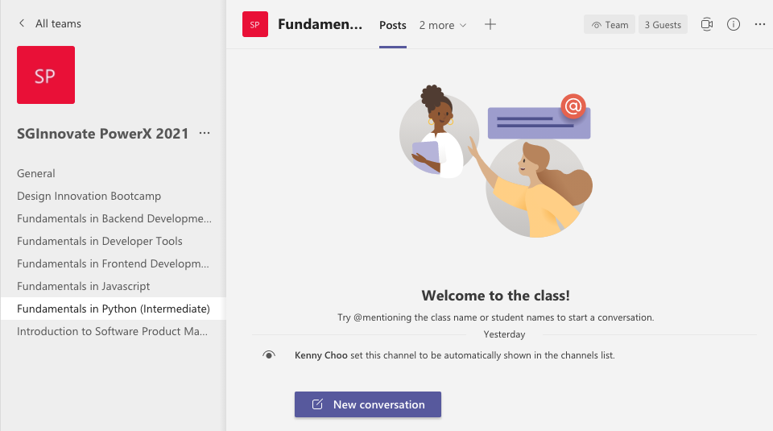
Communication Channel and Consultation
Microsoft Teams
Download:
Desktop App
Mobile App

Slide 11
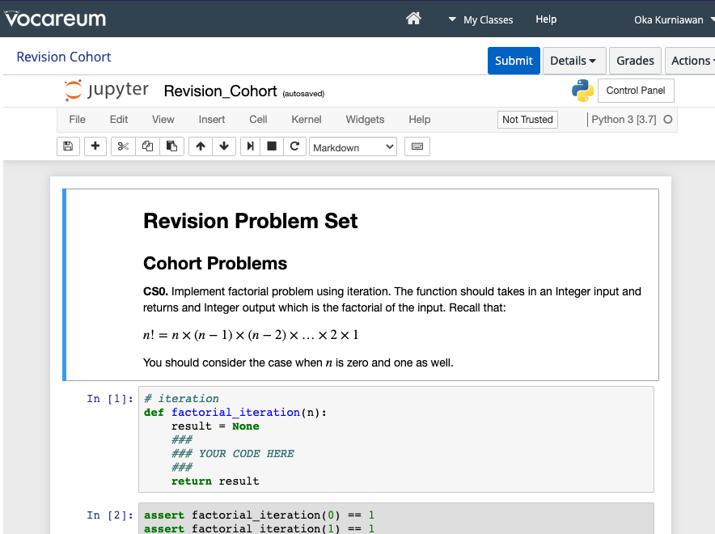
Python and IDE
Python 3.7
You can use any Python distribution
You can use any IDE:
Sublime Text
Atom
Jupyter Lab
VS Code
etc
We will be using Jupyter notebook for problem sets.

Slide 12
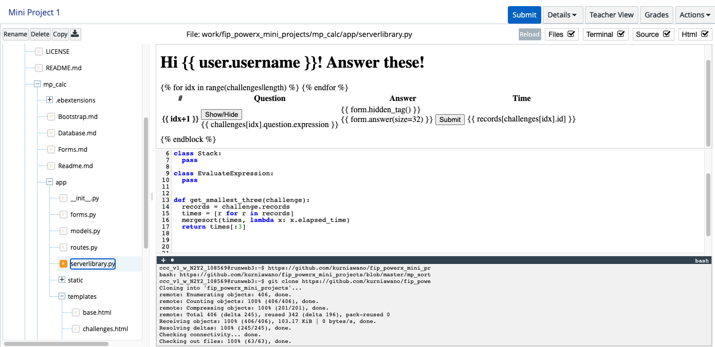
Python and IDE

